Slide 1
2D Physics and Camera Systems
For CSE 3902
By: Matt Boggus

Slide 2
Outline
2D game physics
Terms
Equations
Updating position and velocity
Scrolling cameras
Graphics pipeline
Transforming between coordinate systems

Slide 3
2D Game physics

Slide 4
Physics of motion terms
Position – vector indicating the location of a point relative to the coordinate system origin
Velocity – the rate of change of the position of an object
Acceleration – the rate at which the velocity of an object changes with time

Slide 5
Physics of motion equations
No acceleration
a
m
f
Constant acceleration
v’
v
vave
a

Slide 6
Position update code
Assuming controls modify the velocity of an object, its position Update is:
position += velocity * dt,
where dt is the amount of time passed since the last Update (set manually or via GameTime)

Slide 7
Friction and damping
With no acceleration velocity will only change based on user input
To slow objects down without acceleration, after updating position,
velocity *= speedDecayRate,
where 0 < speedDecayRate < 1

Slide 8
Clamping
Keeping a value within a specified range
Prevent objects from moving off-screen
Prevent objects from moving too fast
Minimum clamping
if (value < min) value = min;
Maximum clamping
if (value > max) value = max;

Slide 9
Other physics issues
User control for jumping height
Input tracking
Sequence on keys/buttons
Controller’s currentState and previousState
State driven
JumpingState (velocity can continue to decrease)
FallingState (velocity can only decrease)
Stuck on ground
Ground plane (y > upperLimit triggers playerDeath)
Grounded state don’t apply gravity but can transition to falling/jumping
“Vibrating” objects
Source rectangle origins aren’t consistent

Slide 10
Coordinate systems, windowing, and cameras

Slide 11
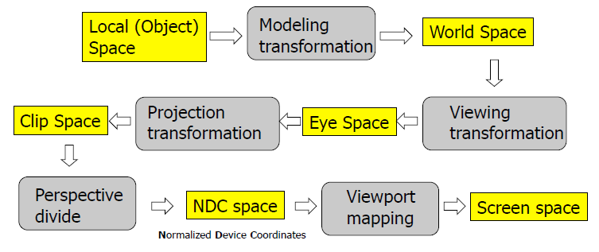
3D Computer graphics
The graphics pipeline is a series of conversions of points into different coordinate systems or spaces

Slide 12
2D SpriteBatch based graphics
Sprite data -> local space
Move based on position in the level -> world space
Move based on position with respect to camera -> screen space

Slide 13
Example (scaled)
Super Mario Bros. Level 1-1 modified from
http://ian-albert.com/games/super_mario_bros_maps/

Slide 14
Example (not scaled)

Slide 15
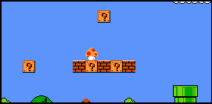
Example (windowed)
Camera’s top left corner is at (227, 57) in world space
For the leftmost question block,
Top left corner is at (256, 127) in world space
When drawn using the camera, top left corner is at (29, 70) in screen space
In general,
Screen space or position to draw =
( worldSpacePosition.x – cameraPosition.x, worldSpacePosition.y – cameraPosition.y )

Slide 16
On camera functionality
Data could include
position, height, width
Methods could include
MoveLeft, MoveRight, MoveUp, etc.
IncreaseHeight, DecreaseWidth, etc.
May want a CameraController to determine when/how to call these methods

